Slide 1
Week 9/10

Slide 2
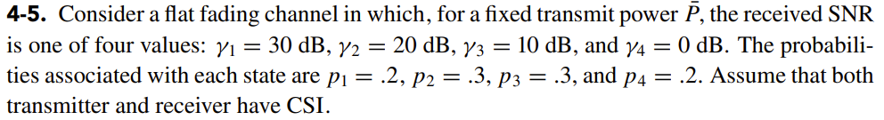
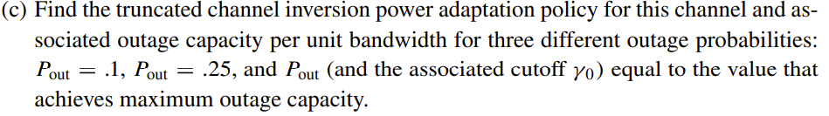
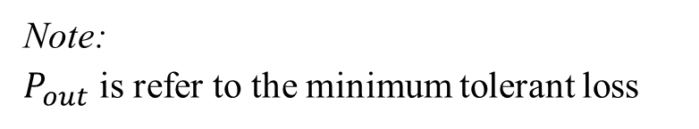
Question 4-5
Note:
$P_{out}$ is refer to the minimum tolerant loss

Slide 3
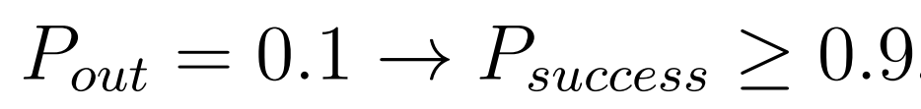
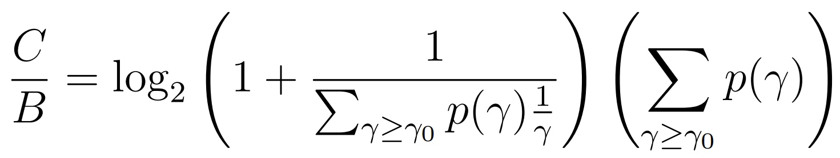
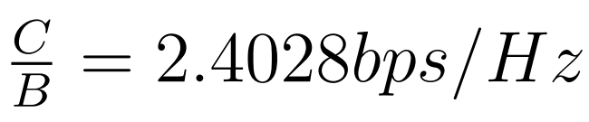


Known:
$$γ_{0}=0 dB$$
From
Result: 2.4028, 3.9678, 4.1462 $bps/Hz$

Slide 4
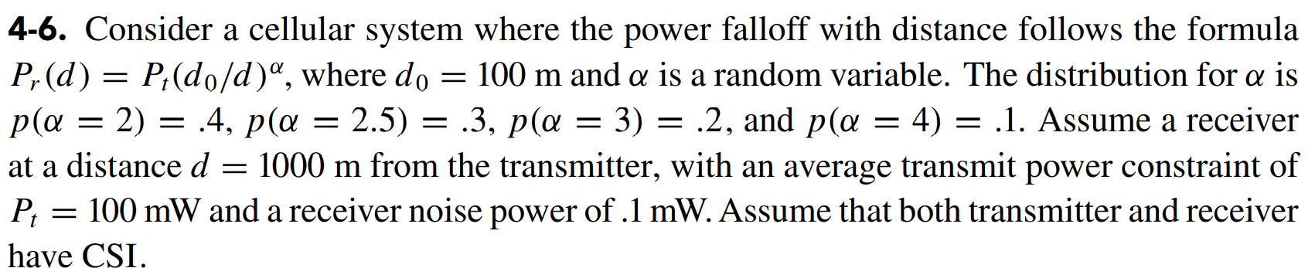

Question 4-6(d)
Result: 0.8066, 1.7955, 2.1510, 1.8802$bps/Hz$

Slide 5
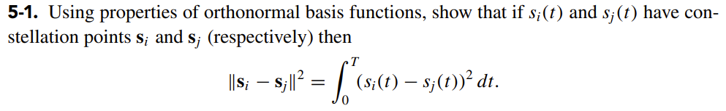
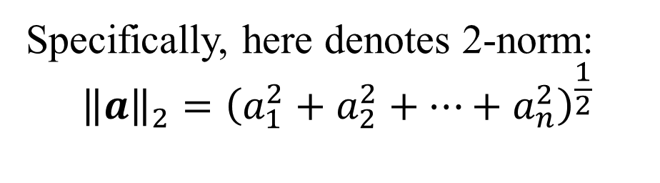
Question 5-1
Hint:
Departing signal into vector form
Specifically, here denotes 2-norm:
$${\left\|a\right\|}_{2}={\left(a_{1}^{2}+a_{2}^{2}+…+a_{n}^{2}\right)}^{\frac{1}{2}}$$

Slide 6
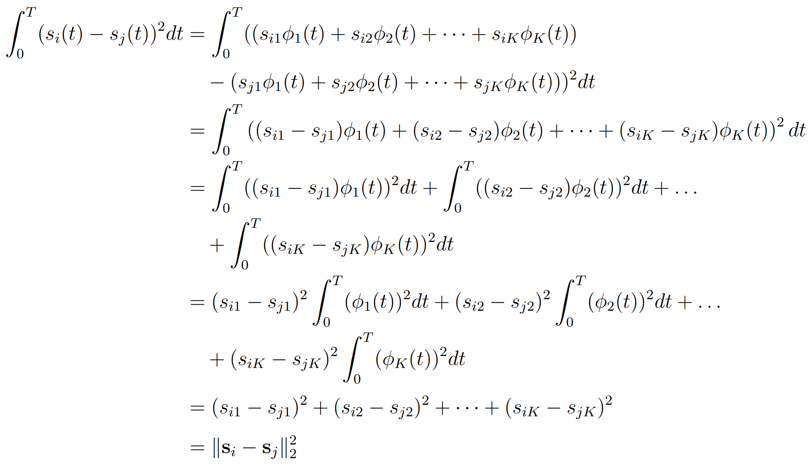
Proof:

Slide 7
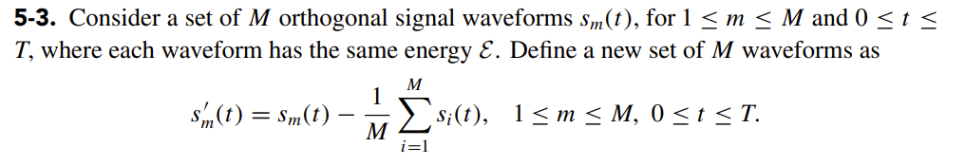
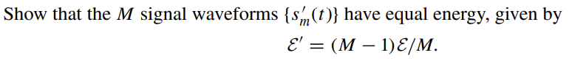
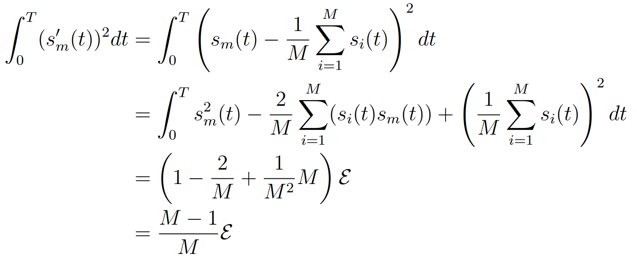
Question 5-3
Proof:

Slide 8
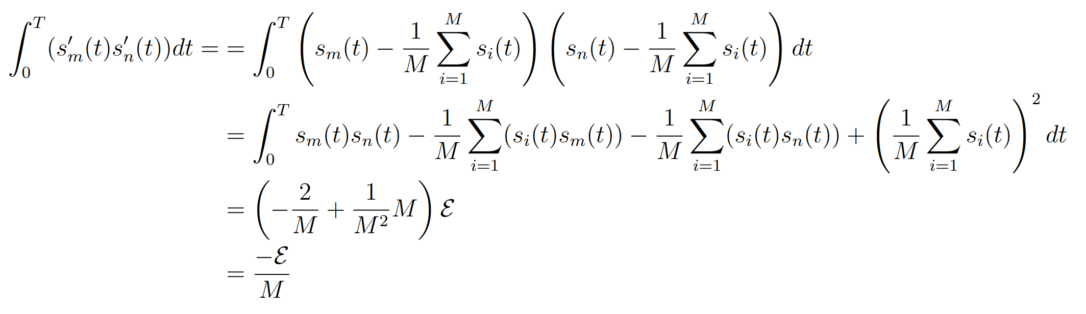
Proof:

Slide 9
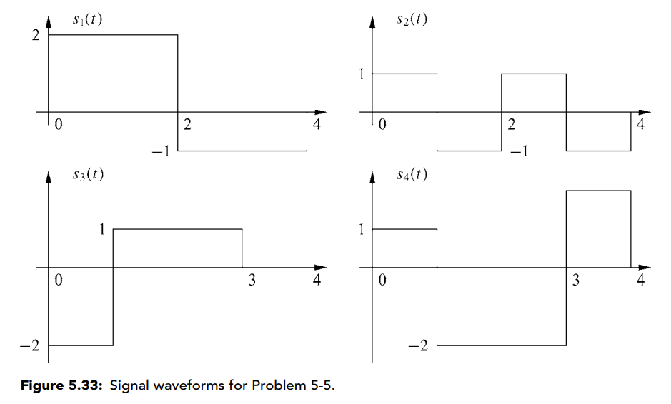
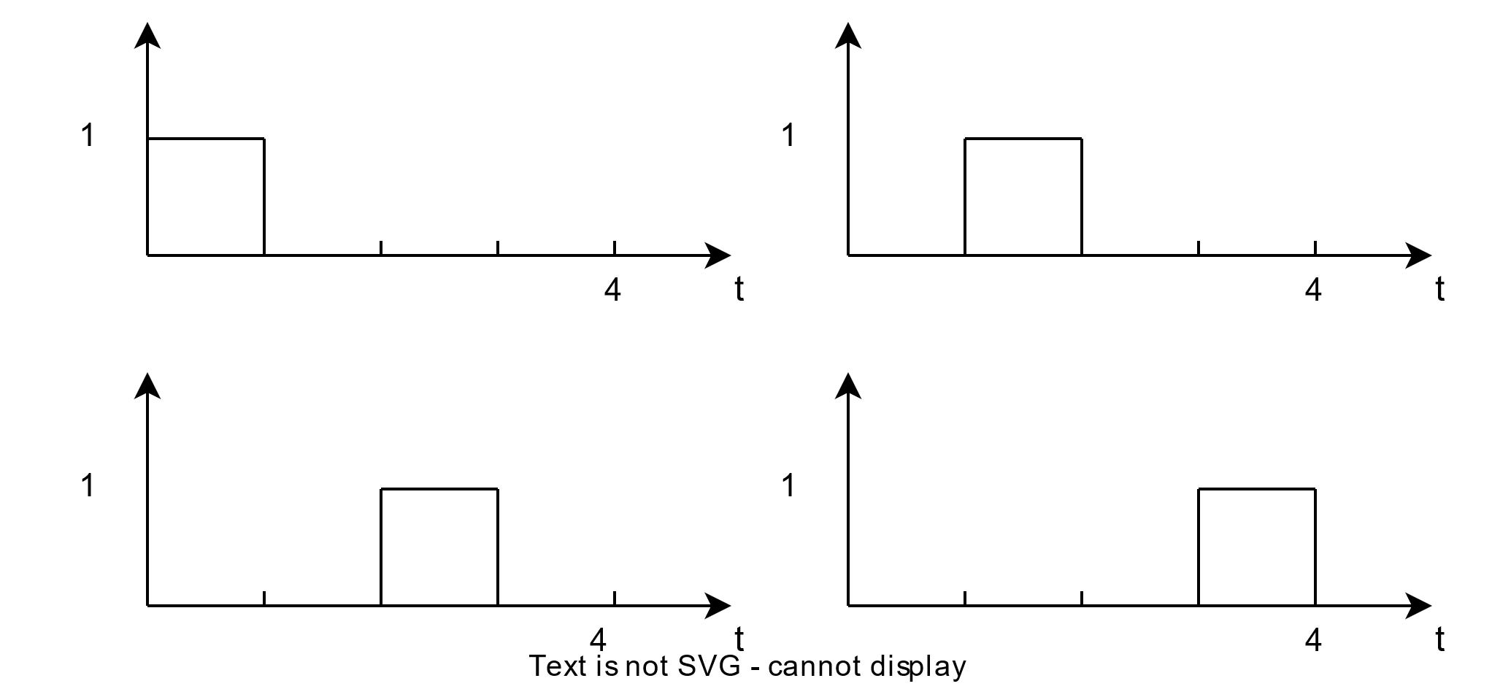
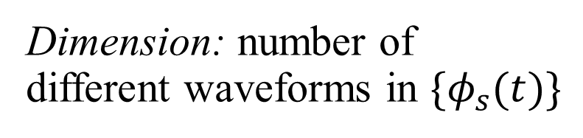
Question 5-5
Dimension: number of different waveforms in $\{φ_{s}(t)\}$

Slide 10
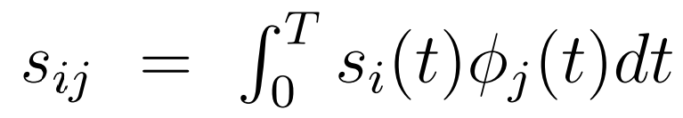
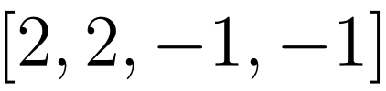




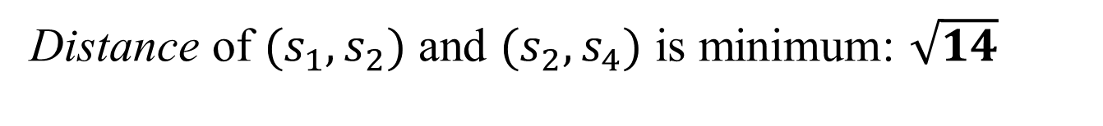
Distance of $(s_{1},s_{2})$ and $(s_{2},s_{4})$ is minimum: $\sqrt{14}$

Slide 11
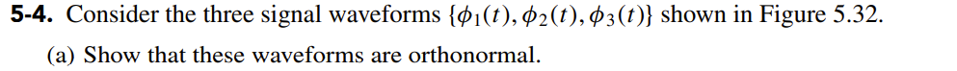
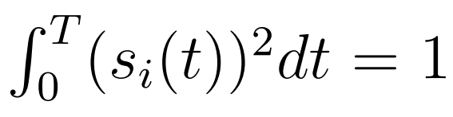
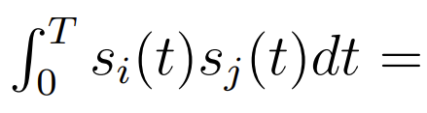

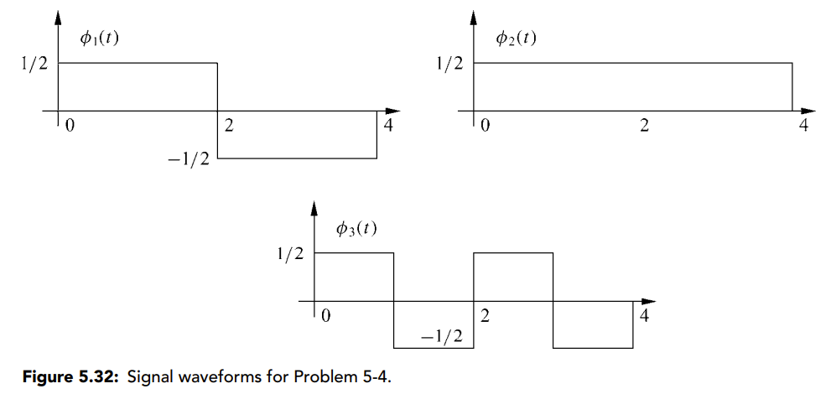
Question 5-4

Slide 12
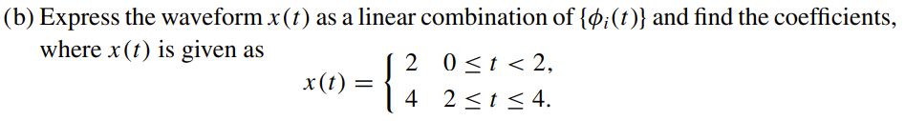

Result is: $−2φ_{1}\left(t\right)+6φ_{2}\left(t\right)+0φ_{3}\left(t\right)$

Slide 13
Question 5-4

Slide 14
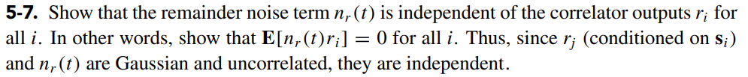
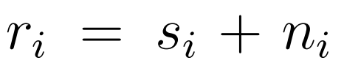
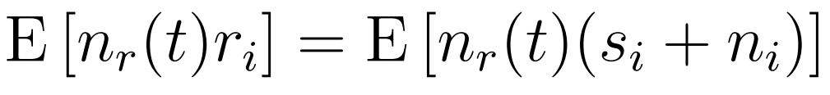

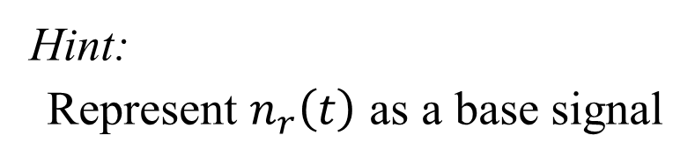

Question 5-7
Equal to 0
Hint:
Represent $n_{r}\left(t\right)$ as a base signal
$$= 0 ?$$

Slide 15
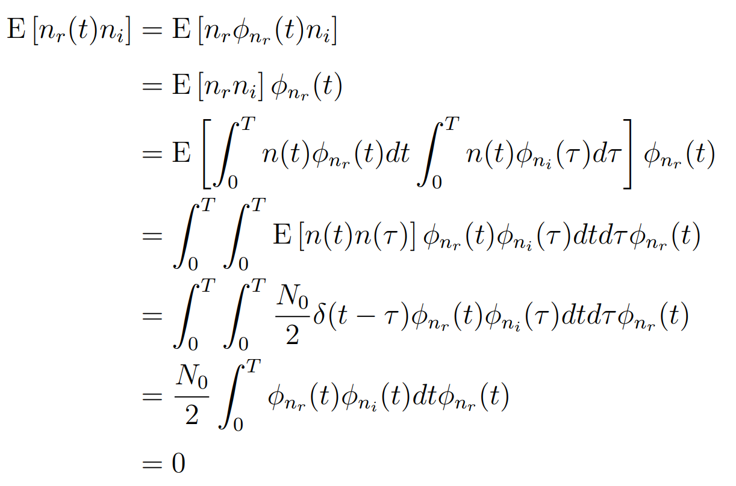

Slide 16
Thank you for listening
Q & A

